Slide 1
Balsamiq vs Moqups

Slide 2
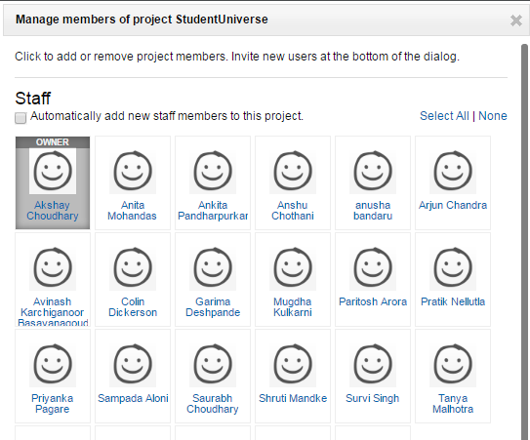
Team - Friendly
Consider the ability to add team members working on the same project Balsamiq without any doubt has an upper-hand over Moqups.
In Balsamiq once we select persons who can edit the project then there is no need to share the project as the saved work of each individual can be accessed easily by the other member.

Slide 3
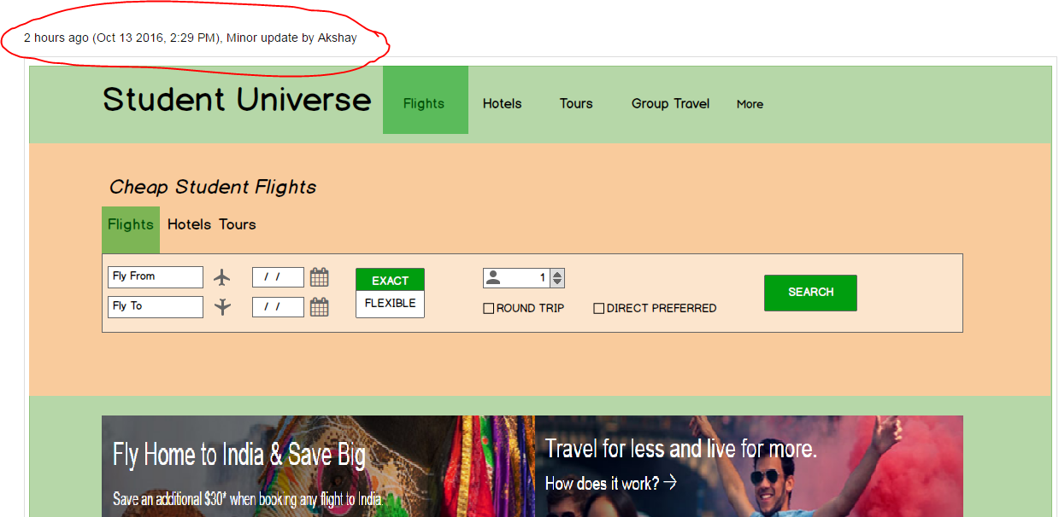
Track History
In Balsamiq we can even track our history of work and what was modified by which team member could be seen which is not a feature in moqups.

Slide 4
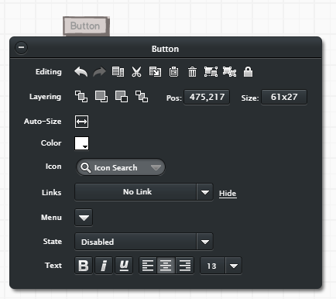
Buttons
Balsamiq has a property where you can disable a button placed on the graph easily but moqups doesn’t have such a feature.

Slide 5

Icons
Balsamiq has a rich variety of icons as compared to moqups. There are some good icons for example, Facebook Icon which can be used in wireframes to reflect the social connections the website has.

Slide 6
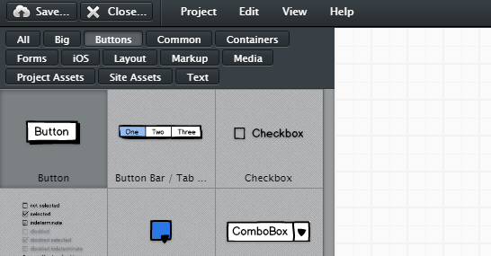
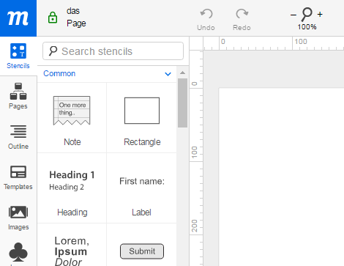
Grouped Stencils
Stencils are very well grouped into categories in Balsamiq thus it is very easy to navigate to the desired stencil easily as compared to moqups where there is only the search bar to search for stencils.
Balsamiq Moqups

Slide 7
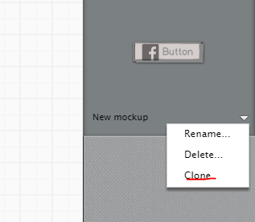
Cloning
In Balsamiq if you want to make just minor changes in the upcoming page then it is easy to clone the same page and make those changes which is not the case in Moqups.

Slide 8

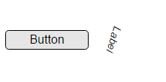
Text Orientation
You can align the text vertically or in any directions with just a button click where as in moqups you don’t have this feature but you can manually drag the text to suit your desired orientation.
Balsamiq Moqups

Slide 9

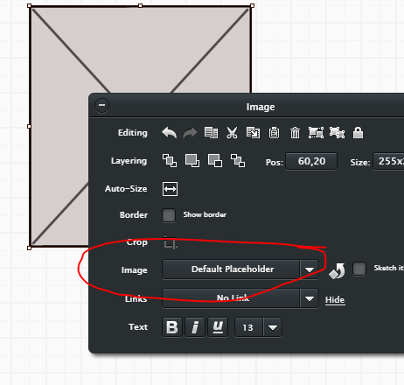
Easy to add Image
Images are very easy to add in moqups as compared to Balsamiq. In moqups you can directly upload the project in your project and use it but in Balsamiq there is another step involved where you first need to set a space for an image by selecting it from stencils and then you can upload your image at that place.

Slide 10
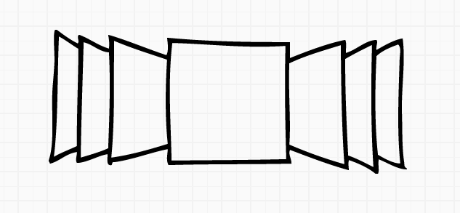
Full Screen
In Balsamiq you have an added stencil for adding image carousel since most of the modern day websites have a carousel feature and hence Balsamiq has an upper-hand compared to moqups even in this aspect.

